Slide 1

7376212CT103 & ANUJ B 7376212CT124 & KAVIN KUMAR P 7376212CT141 & PRAGUSHPATHI P 7376212CT150 & SANKAR PRASATH S
WEB SCRAPING WITH ROBOTIC PROCESS AUTOMATION
Under guidance of
Dr. S. Logeswari
Professor Department of CSE
BIT, Sathy.

Slide 2
ABSTRACT
Web data extraction is one of the major domains in which Robotic Process Automation(RPA) has a lot of
potential in today's society. Social media data collecting is becoming increasingly crucial as organizations
strive to better understand their customers and their attitudes. The problem is that most social media
networks no longer aid you in automatically gathering data, and doing so manually could take a long time,
need a huge number of people, and be prone to errors. Web scraping, often called web harvesting or web
data extraction, is a sort of data scraping that collects data from websites. Using a fully web scraping solution
based on Robotic Process Automation (RPA) could be a more easier and preferred approach to achieve this
goal. This proposed work includes the extraction of stock details from the hot stocks website using RPA
technology and stores the details in an excel for future analytics. It is implemented using the Automation
Anywhere tool.

Slide 3
AGENDA
INTRODUCTION
PROBLEM
SOLUTION
PROCESS
PROPOSED METHOD
SCENARIO
PROTOTYPE
CONCLUSION

Slide 4
INTRODUCTION
Web data extraction is one of the major domains in which Robotic Process Automation has a lot of potential in today's society. Social media data collecting is becoming increasingly crucial organizations strive to better understand their customers and their attitudes. The problem is that most social media networks no longer aid you in automatically gathering data, and doing so manually could take a long time, need a huge number of people, and be prone to errors.
Webs craping, often called web harvesting or web data extraction, is a sort of data scraping that collects data from websites. Using a fully web scraping solution based on Robotic Process Automation(RPA) could be a more easier and preferred approach to achieve this goal.
This proposed work includes the extraction of stock details from the hot stocks website using RPA technology and stores the details in an excel for future analytics. It is implemented using the Automation Anywhere Toll.

Slide 5

PROBLEM
______________________________________________
The problem is that most social media networks no longer aid you in automatically gathering data, and doing so manually could take a long time, need a huge number of people, and be prone to errors.

Slide 6

SOLUTION
Productivity Improvements.
Reduce Mistakes and Improve Compliance.
Improve Customer Experience.
Improve Employee Experience.
Improve speed, quality, and productivity.

Slide 7
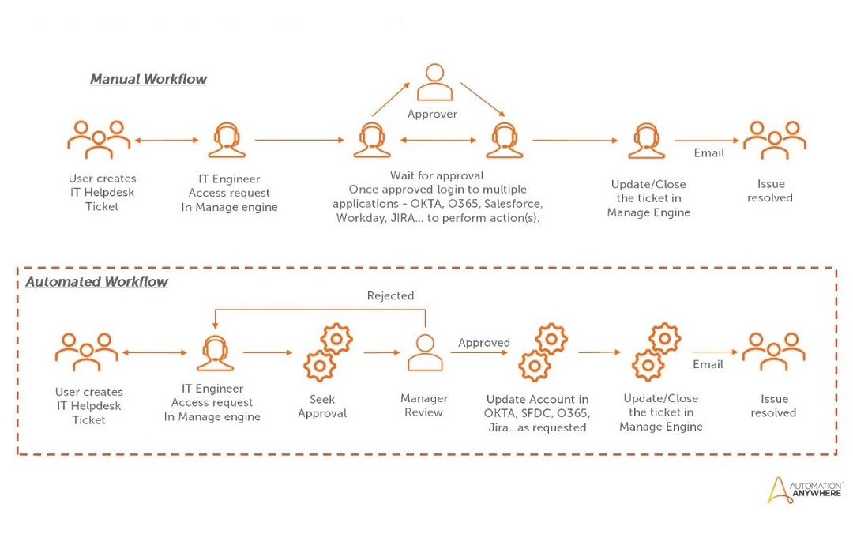
PROCESS

Slide 8
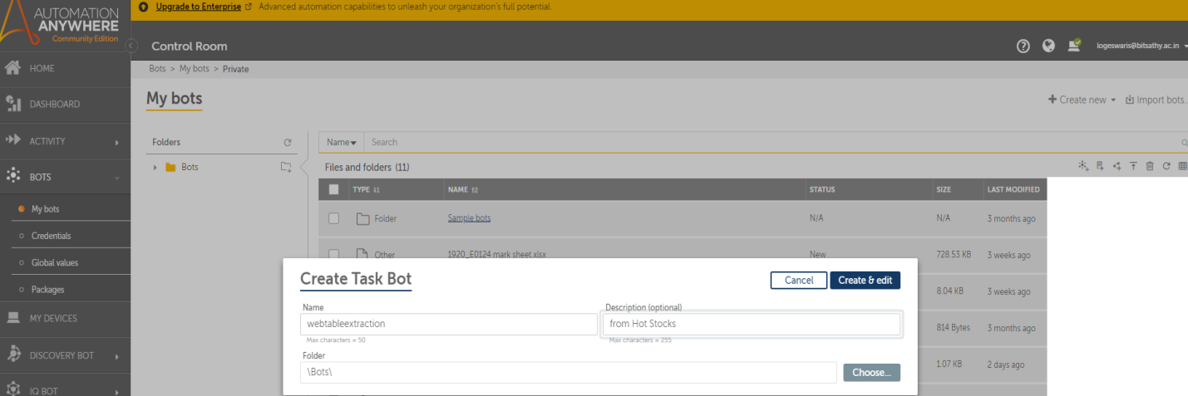
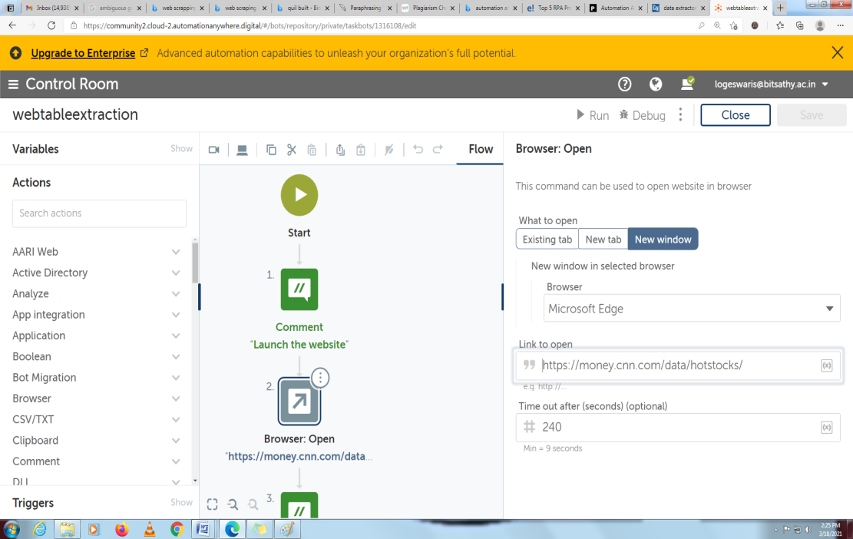
Proposed Method:
2.Open a Browser to launch the URL:
https://money.cnn.com/data/hotstocks
1. Creation of a Bot

Slide 9
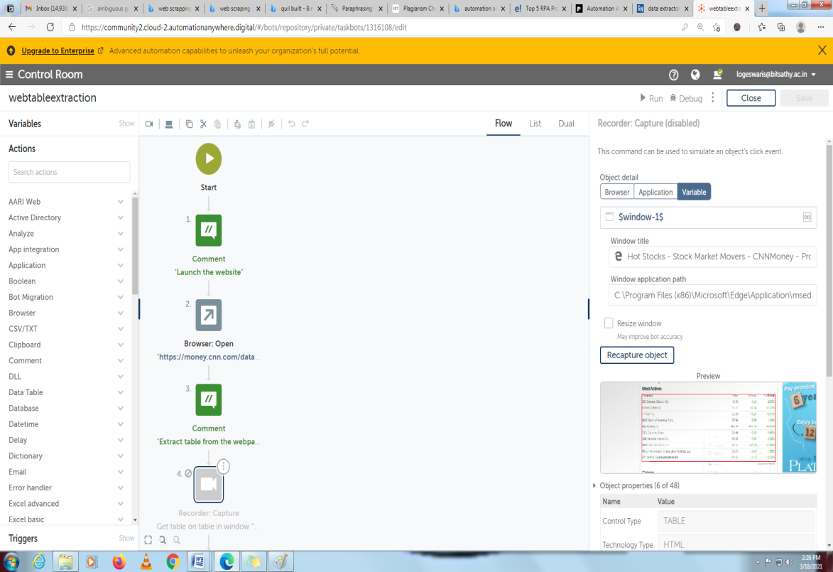
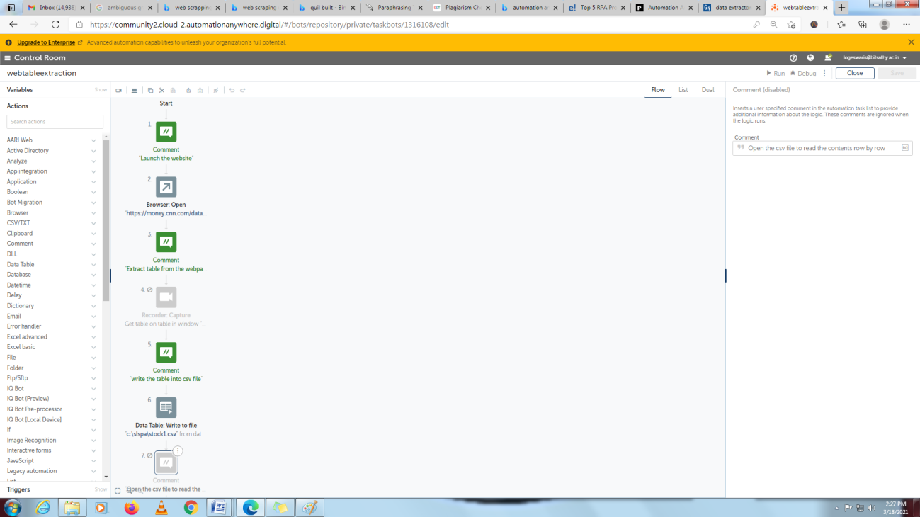
3. Table Extraction using Recorder-Capture
4. Store the table as .csv file

Slide 10
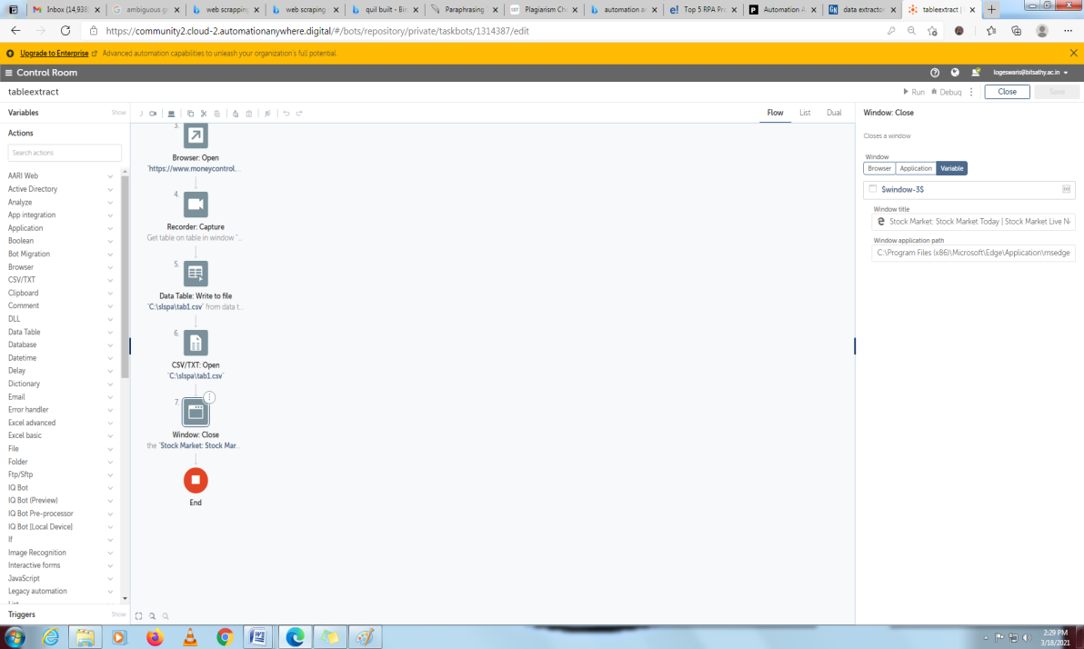
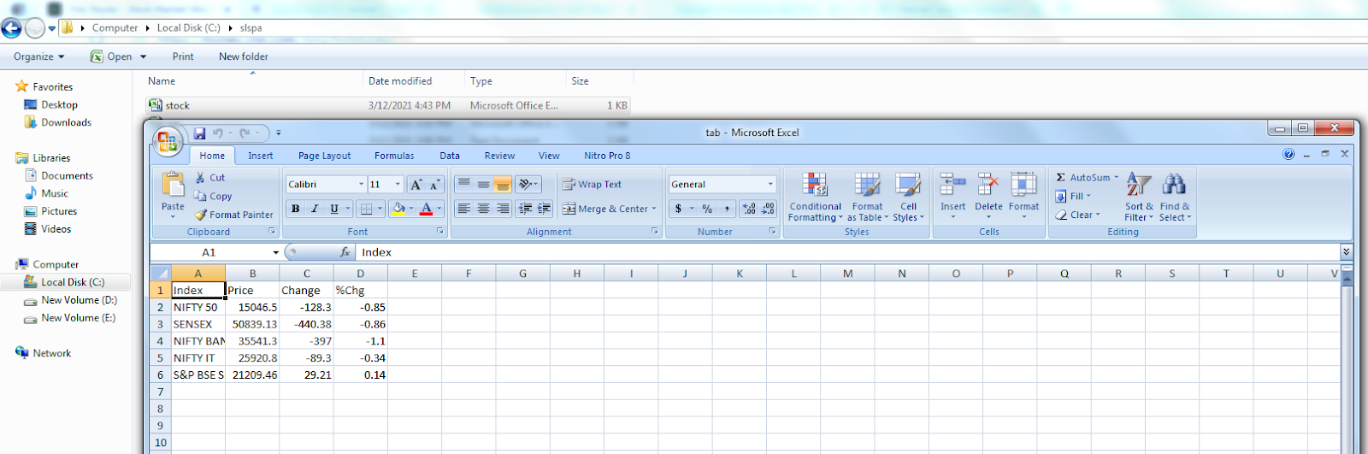
5. Close the file
6. Select the option: Save and then Run:
The output is stored in the file c:\slspa\stock.csv as
follows

Slide 11
SCENARIO 1: Web Scraping About Hiring Companies
The objective of this paper is to build a BOT to open a browser window to the Hot Stocks website, extract the data from a table, and write it to a CSV file on the desktop. The proposed task bot is built with the screen recorder with capture option available in Automation Anywhere to extract a table from a web page. In an Excel environment, the extracted table is saved as a.csv file, which can then be opened and read to show the contents of the table row by row.

Slide 12
SCENARIO 2: Automation in Education field
Many schools and college, They started using automated bots. But still there are many sectors want to be updated, it can be used in many ways like calculating marks of students, mailing student’s grade to parents and bot that can reply to students queries.

Slide 13
CONCLUSION:
Even though RPA software can be found across all industries, significant adopters include insurance companies, banks, and telecom companies, and utility companies. RPA tools should consist of role-based security capability to ensure action specific permissions. They should also offer configuration as well as customization of encryption capabilities for securing certain data types.

Slide 14
Thank you!

